Slide 1
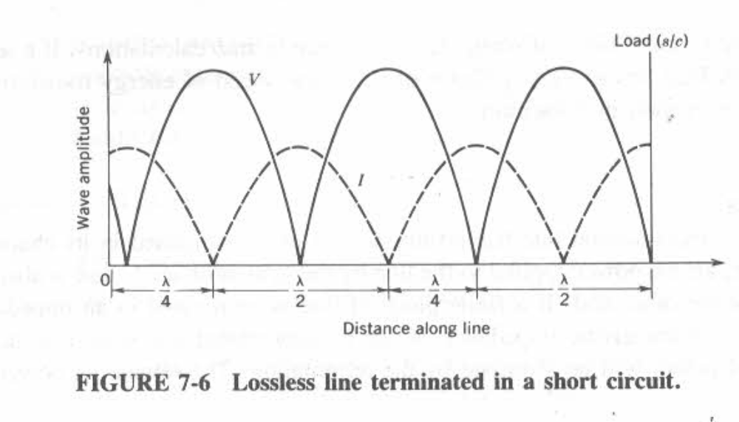
Standing Wave Pattern 0f Short Circuit

Slide 2
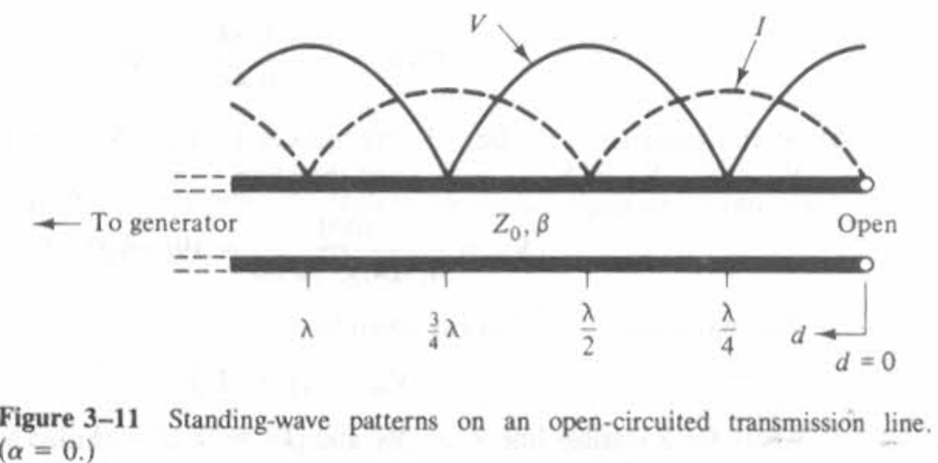
Standing Wave Pattern 0f Open Circuit

Slide 3
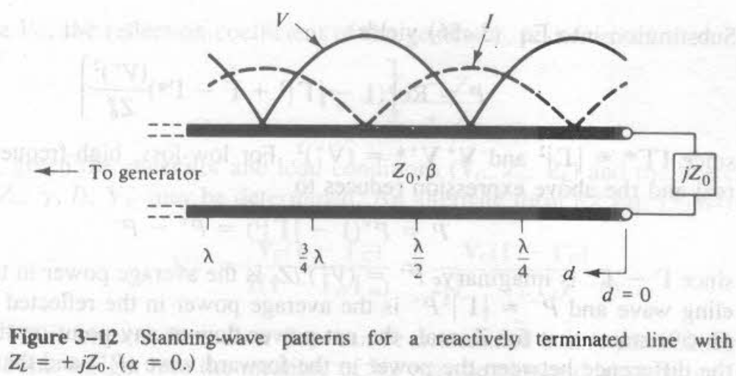
Standing Wave Pattern 0f Reactive Termination

Slide 4
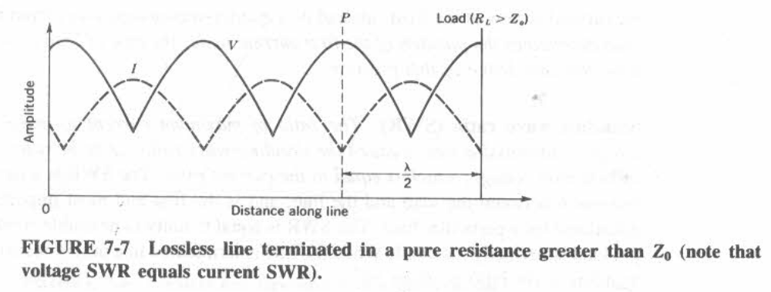
Standing Wave Pattern 0f Pure Resistance

